Slide 1
HCI Project
Title : Cogito – Marketing Campaign Solutions
Nithish Ranjan : PES1201700965

Slide 2
Need Finding..
The main motivation behind this website was in the present times campaigning has become an increasingly challenging task for organisations who wish to market a particular product ,event , fest etc. To help organisations do their events in a more easier and a efficient way we have this website Cogito. Our website helps companies have a seamless planning and execution experience for their campaign. Business partners in the current times have a tough time finding websites and blogs that can help them in improving their businesses. Hence to avoid the same this website is designed to help them better. The industry standard features that we offer include blogs, idea pitching area, planning an event. We basically help companies with their digital marketing domain. Thus using our platform, we help understand customer preference and help them by giving them personalized communication, thus ensuring efficient business process management.

Slide 3
Low fidelity prototype..
Demonstrate on how seamless and efficient several organisations would find it in accessing the website using the concept of storyboarding.
Intially for the storyboarding we start off with make the UI/UX very engaging for the user.

Slide 4
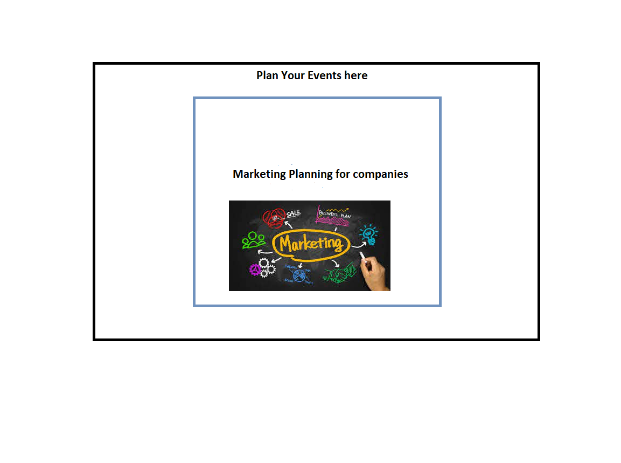
Initially there are two images that are popping up on a periodic basis, here user selects one of the option based on his requirements.

Slide 5
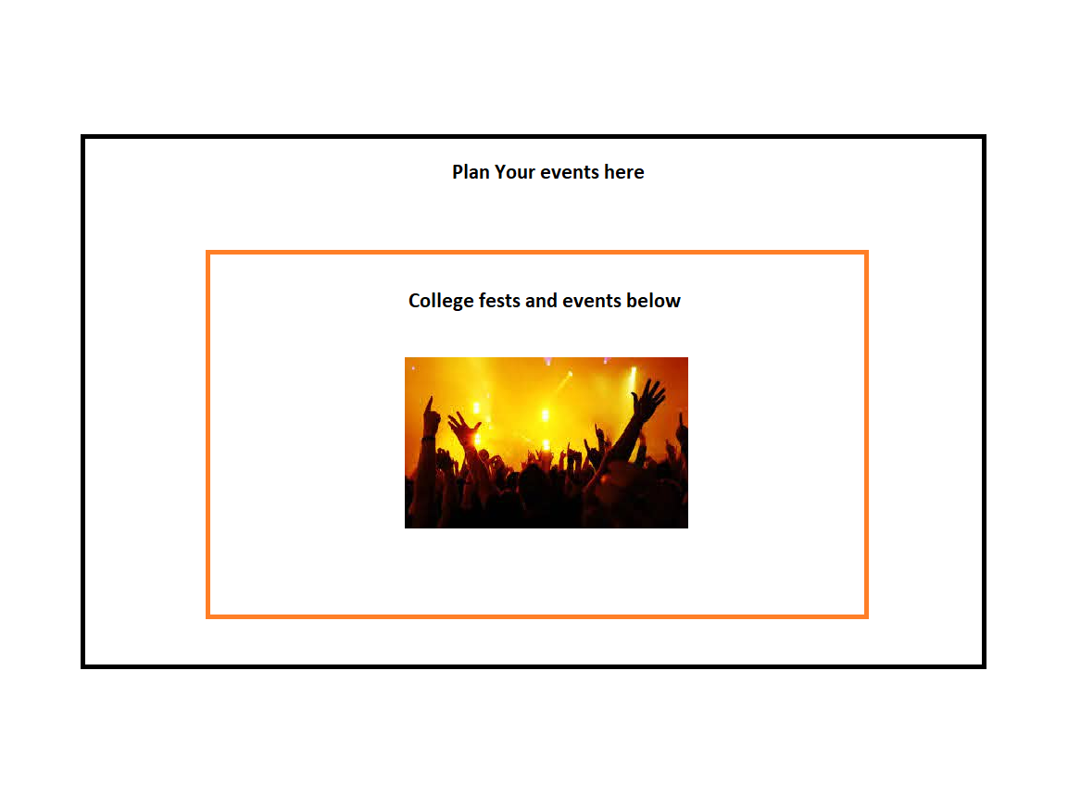
Here if the user chooses the college fests option then it will ask for the necessary details.

Slide 6
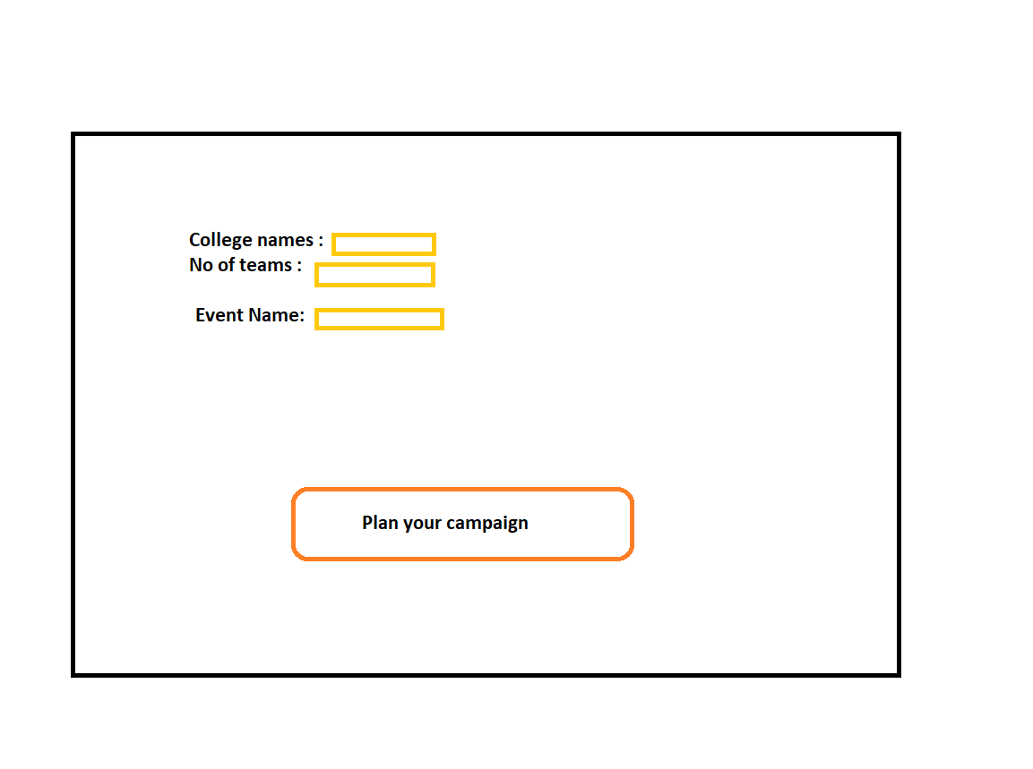
Give in the details and then the campaign will be planned accordingly.

Slide 7
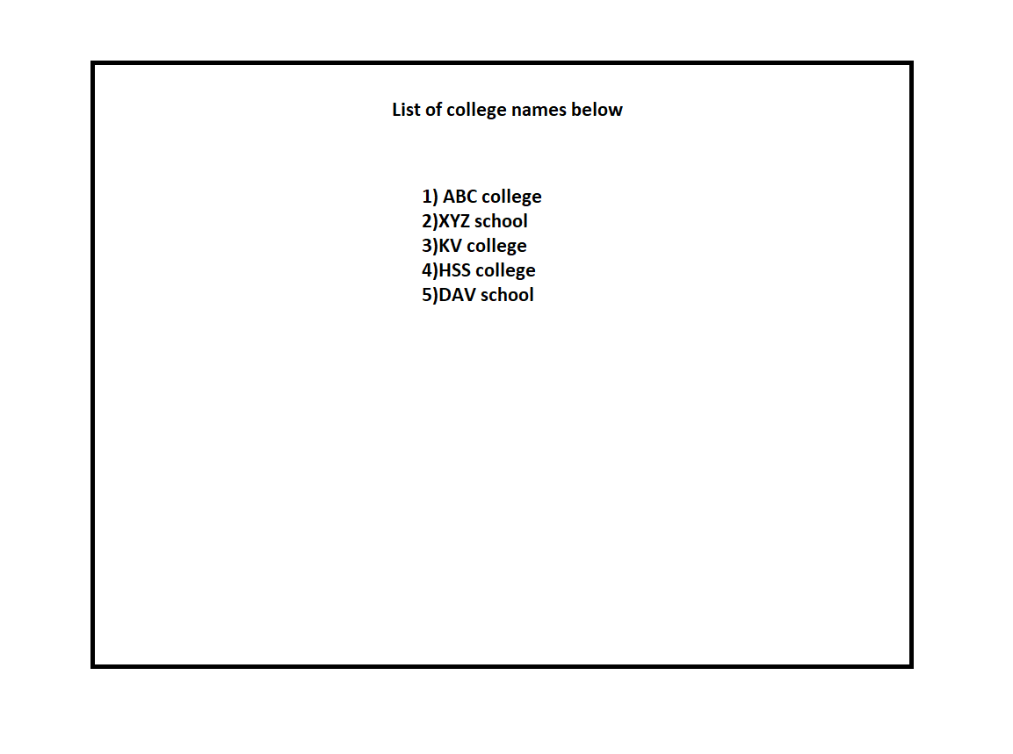
The details and the results will be shown this way.

Slide 8
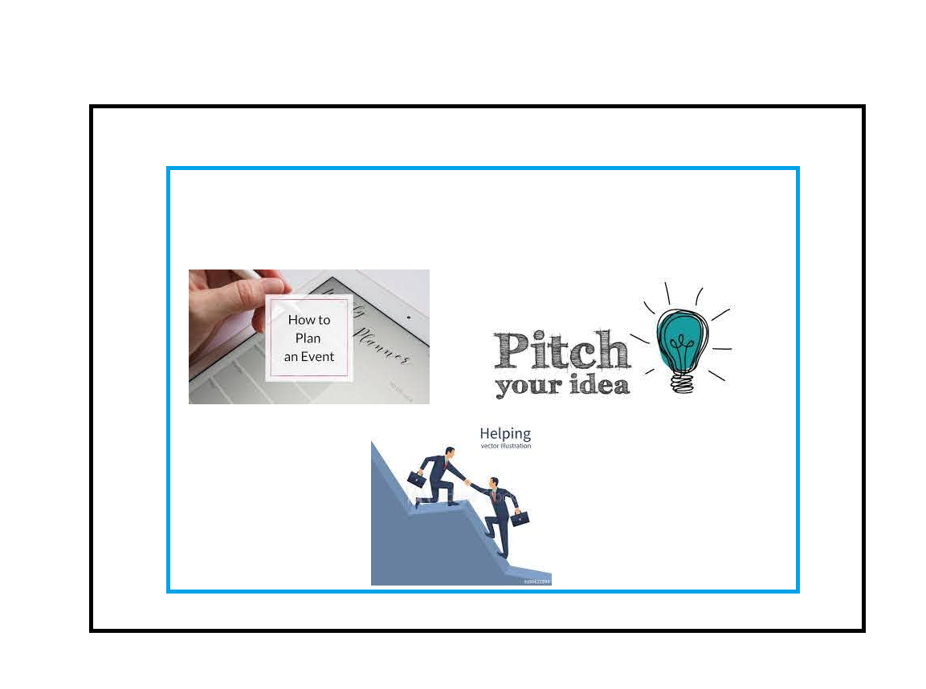
Incase the user needs help in improving his business or pitching in a new idea he can choose from one of the options.

Slide 9
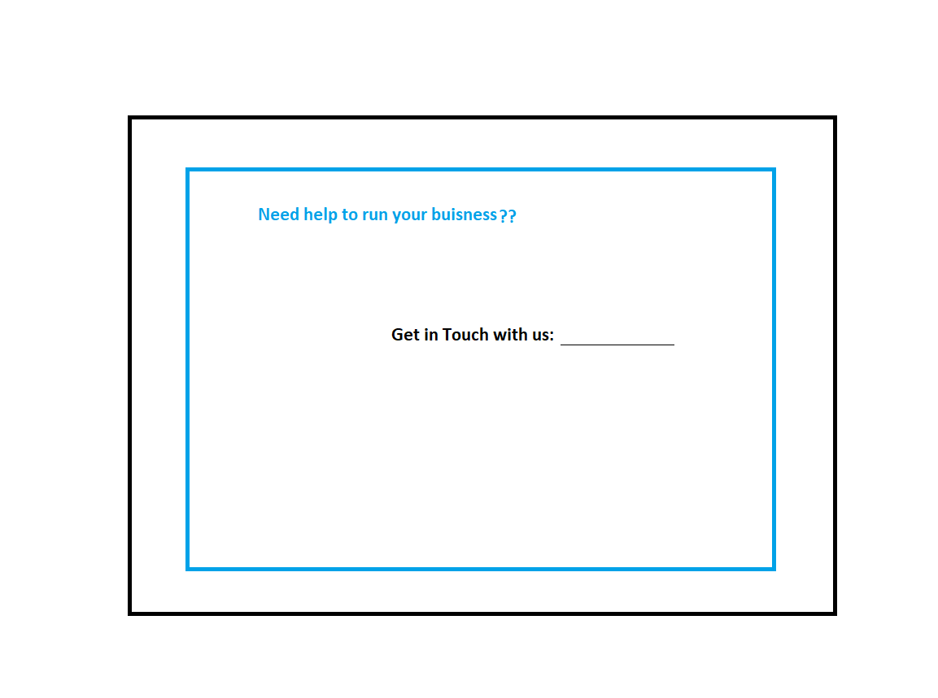
Suppose he clicks on the option need help in business one of our executive will get in touch with the client.

Slide 10
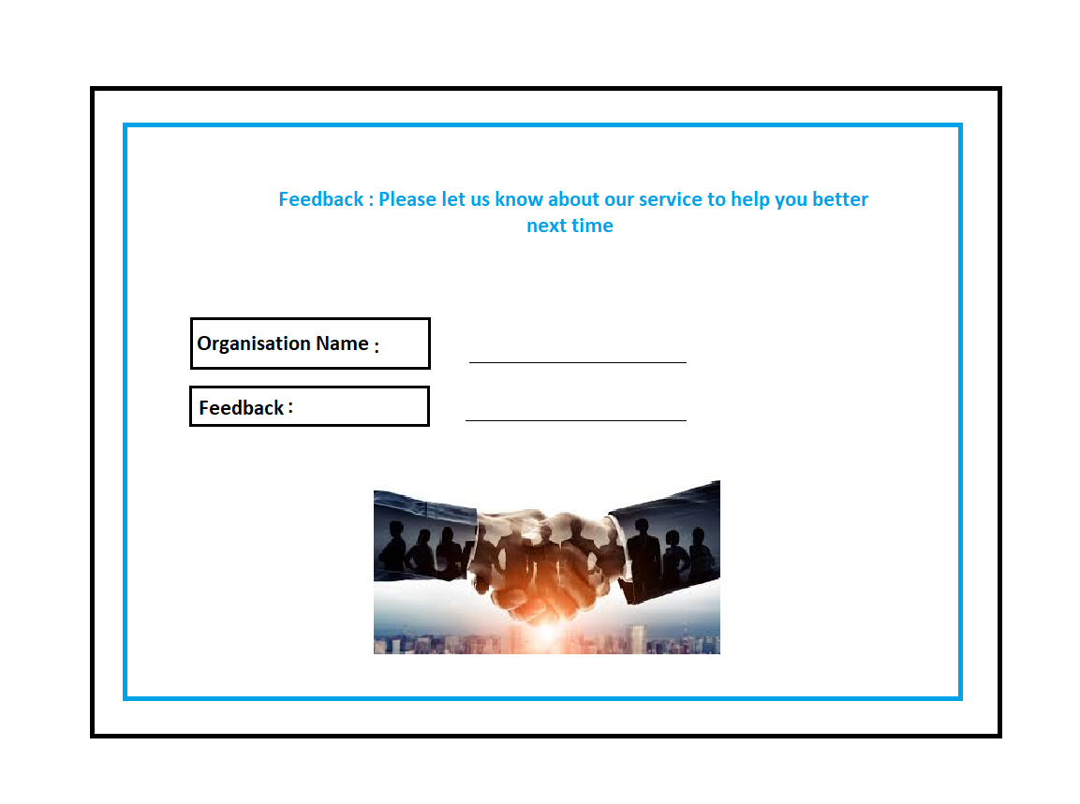
Finally we ask the user/client for his/her feedback to serve them better again.

Slide 11
Technology used ..
HTML
CSS
JAVASCRIPT
PHP
DATABASE

Slide 12
Heuristic Evaluation..
Visibility of system status : System will show all the options , images and displays the result as expected.
User control and freedom : Offers user to communicate with the system if he wants to do it again and also plan his campaign accordingly.
Consistency and standards :The system is consistent with all the requirements and inputs which are entered.

Slide 13
Heuristic Evaluation..
Match between system and the real world : The language used to communicate by the user with the system is extremely easy , convenient as used in daily life.
Recognition rather than recall : The system appears to be extremely engaging for the user and can be used with ease.
Aesthetic and minimalist design : The information that is present on the system is only that which is absolutely required and no additional extra information is available.

Slide 14
THANK YOU

